Slide 1
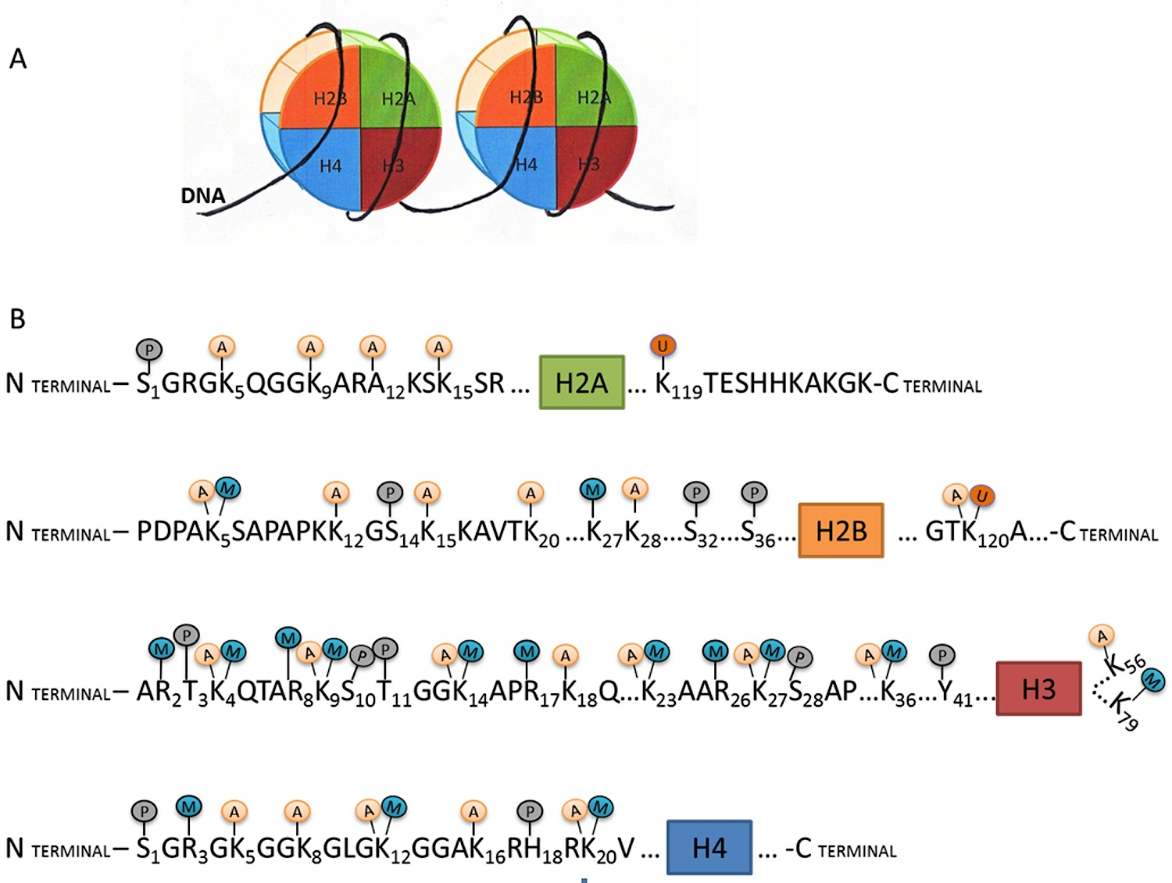
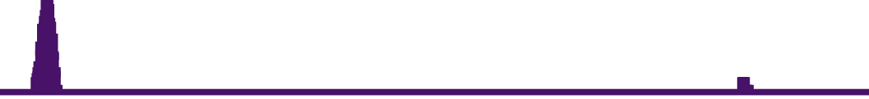

Epigenetic interaction between histone modifications affecting gene expression
Xulong Wang, Robyn Ball, Gregory W. Carter
The Jackson Laboratory, Bar Harbor, ME USA
ABSTRACT
Histone methylation and acetylation are critical to define the epigenetic landscape of cells and tissues, and diverse patterns of histone modification combinations are found to be closely associated with genetic features including promoters, enhancers, and repressors. However, the rich diversity of epigenetic features along the genome of an individual tissue as well as the diversity at the same genomic region over different tissues, make the functional relevance of epigenetic features complicated. Aiming at uncovering the complete functional elements of the mouse genome, the ENCODE mouse project has generated a significant amount of data on histone modification, transcription factor binding, and gene expression in 80 cell and tissue types. In this study, we focus on how H3K4me1 and H3K4me3 marks interact with each other to jointly affect gene transcription by integrating histone modification and gene expression data on 11 samples from the ENCODE mouse project. Firstly, we identified that both H3K4me1 and H3K4me3 are highly enriched in the exon and promoter regions, as compared with the intron and intergenic regions. Secondly, H3K4me3 intensities negatively correlate with gene expression level depending on genomic locations. H3K4me3 intensities in the transcript body, including exon and intron, tend to regulate gene transcription positively. On the other hand, H3K4me3 intensity in the promoter region tends to negatively regulate gene transcription. Lastly, we identified a strong negative interaction effect between H3K4me1 and H3K4me3. The presence of H3K4me1 in the vicinity of H3K4me3 sites tends to overwrite the positive effect of H3K4me3 on gene transcription. Our approach can be directly extended to include genotype information in addition to histone modification information to study how genetic variants and epigenetic states combine to regulate gene transcription.
RESULTS
Interaction between H3K4me1 and H3K4me3
We studied interactions between H3K4me1 and H3K4me3 with linear regression on each combination of epigenomic feature pair (see the x-axis label of the figure below) with both additive and interactive terms.
Distribution of H3K4me1 and H3K4me3 marks
We started our analysis by quantifying the relative distribution of H3K4me1 and H3K4me3 peaks with genetic promoters, exon, intron, and intergenic regions from mouse ENCODE ES-Bruce4 sample. Peak lengths were quantified as the total length of the peak along the genome in the given genomic regions. Peak numbers refer to the number of individual peaks in the given regions.
Effect of interactive terms in the linear model. The x-axis shows each combination of epigenomic feature pair. The y-axis is the effect size of the interactive term in the linear model. We identified a pervasive negative interaction between H3K4me1 and H3K4me3 marks at different genomic locations.
INTRODUCTION
Genomes are regulated epigenetically by chromatin and histone protein modifications, which play critical roles in gene transcription. Histone modification is the most studied form of epigenetic regulation, and tissue-specific patterns have been extensively assayed. However, how different histone modification marks act together jointly to affect gene transcription is poorly understood. Using the large amount of ChIP-Seq and RNA-Seq data in the mouse ENCODE project, we aim to study the interaction between H3K4me1 and H3K4me3 and its effect on gene transcription.
H3K4me1 overwrites the positive effect of H3K4me3
To study the effect of the H3K4me1 and H3K4me3 interaction in the transcript region, we compare four linear models:
H3K4me1
H3K4me3
Overlap
We found that both H3K4me1 and H3K4me3 peaks are highly enriched in exon and promoter regions as compared to intron and intergenic regions.
The peak numbers are enriched in exon and promoter regions to a greater degree than the peak length.
Overlaps of H3K4me1 and H3K4me3 peaks show the same enrichment pattern. We see similar enrichment patterns in the mouse ENCODE liver and MEL samples.
Effect of individual marks on gene transcription
Correlation between gene transcription and the level of individual histone modification features were quantified by Pearson’ correlation method and p-values for correlation coefficients were corrected for false discovery rate (Jones and Smith, 1992).
A subset of 3670 genes that showed moderate expression variations among 11 mouse ENCODE samples (cerebellum, ES-Bruce4, heart, kidney, liver, MEL, intestine, spleen, testis, thymus, brain) were used in our analysis.
H3K4me1 and H3K4me3 peak information are described as peak intensity, which is defined as the length of the ChIP-Seq peak divided by the length of a given genomic region (promoter, exon, intron, transcript).
METHODS
RNA-Seq and ChIP-Seq data from the mouse ENCODE project were used for our study (www.mouseencode.org). Gene expression levels were estimated by RSEM (Li and Dewey, 2011) based on the mouse mm10 assembly and quantified as log2 transformed TPM. ChIP-Seq peaks on H3K4me1 and H3K4me3 were estimated by MACS (Zhang et al., 2008) and segmented in 200 base pair units and transformed into a 0 and 1 binary format, which represents the absence and presence of a ChIP-Seq peak in a given 200bp genome region.
Left: Effect sizes of H3K4me1.tx, H3K4me3.tx, and their interaction in the four models. Models 2, 3, and 4 show positive effect of H3K4me3 on gene transcription. Model 4 shows a clear negative interactive effect between H3K4me1 and H3K4me3 in the transcript region.
Right: The distribution of gene transcription levels in four groups of genes defined by their histone modification levels. me1- and me1+ represents genes with the lowest 25% and highest 25% quantiles of H3K4me1 level, respectively. me1-/me3+ represents a group of genes with the first 25% quantile level of me1 and last 25% quantile of me3 level.
H3K4me1
CONCLUSIONS
H3K4me1 alone in exon or promoter regions negatively regulates gene transcription. H3K4me3 alone in the transcript body regions positively regulates gene transcription but when present in the promoter region, has a negative effect.
A strong negative interaction between H3K4me1 and H3K4me3 in the transcript region overrides the positive effect of H3K4me3 on gene transcription.
H3K4me3
M
Promoter
M
M
M
M
M
M
5′ UTR
EXON
EXON
3′ UTR
H3K4me1
H3K4me3
 | Genetic regions
 | Promoter (2K upstream of TSS), Transcript, Exon, Intron
 | Histone marks
 | H3K4me1, H3K4me3
 | Epigenomic features of given mark in given genetic regions
 | H3K4me1 (Promoter), H3K4me1 (Transcript), H3K4me1 (Exon), H3K4me1 (Intron) H3K4me3 (Promoter), H3K4me3 (Transcript), H3K4me3 (Exon), H3K4me3 (Intron)
H3K4me1 peak intensities in the exon and promoter regions are significantly anti-correlated with gene transcription levels.
H3K4me3 peak intensity shows opposite effects depending on genomic locations. H3K4me3 in the intron and transcript regions are positively correlated with gene transcription, while h3K4me3 in the promoter regions are negatively correlated.
Acknowledgement
This work was supported by a fellowship from The Pyewacket Foundation.

